Slide 1

Monte Carlo and RL
Medhansh Sankaran, William Donnell-Lonon

Slide 2

Introduction to Monte Carlo
Monte Carlo is a statistical method that uses random sampling to estimate numerical results when it is hard/impossible to compute them exactly.
Instead of solving analytically, we simulate many times using random inputs and average the results.
It leverages the Law of Large Numbers to approximate quantities that are difficult to compute
Notes:
Suppose we have a square with side lengths of 2, so area 4. The inscribed circle has radius 1 and area pi. When randomly placing points, the ratio should be pi/4.

Slide 3




How it Works
Define a problem in probabilistic terms.
1
Generate random samples from the defined probability distributions.
2
Evaluate an outcome or function for each sample.
3
Aggregate results (eg: mean, variance, probability estimate)
4

Slide 4
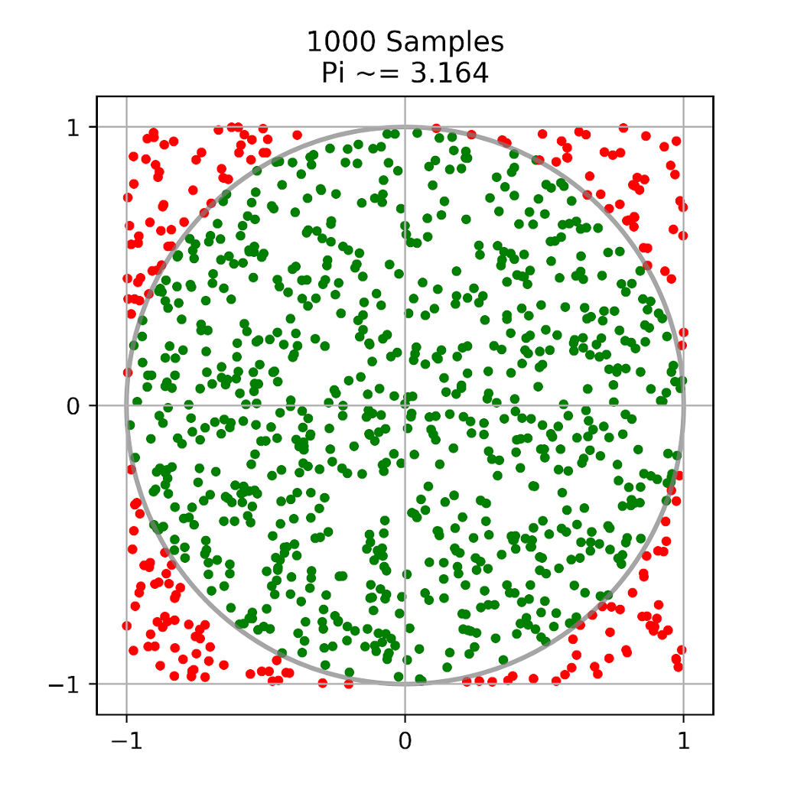
Example
To estimate the value of π, we randomly place points within a 2x2 square:
The ratio of points in the inscribed circle (with radius 1) versus total points is approximately π/4.
The more points we sample, the closer the approximation (Law of Large Numbers).
Notes:
Suppose we have a square with side lengths of 2, so area 4. The inscribed circle has radius 1 and area pi. When randomly placing points, the ratio should be pi/4.

Slide 5

Monte Carlo in Reinforcement Learning

Slide 6
Key Terms to know
Agent – the machine program that is learning and making decisions
Environment – the system of rules, objects, and rewards the agent interacts with
State – A snapshot of the environment from the agent’s perspective
Episode – A full run of states, actions, and rewards from start to finish

Slide 7

Monte Carlo in Reinforcement Learning
Monte Carlo methods estimate how good a state or action is by averaging the actual rewards an agent receives over many complete episodes.
Example: In chess, one episode is one full game. If we track how much material we win in each game and then average those results, we get an estimate of how good certain positions or moves are.
Monte Carlo is useful when we don’t know how the environment works internally — the agent learns only from experience.
For each state (or state–action pair), we estimate its value by averaging the returns received after visiting that state across all episodes.

Slide 8
Pros and Cons
Pros
Model-free (no transition probabilities needed)
Simple to implement
Works well with delayed rewards
Cons
Requires episodes to finish → slow feedback
High variance in estimates
Can be slow to converge

Slide 9
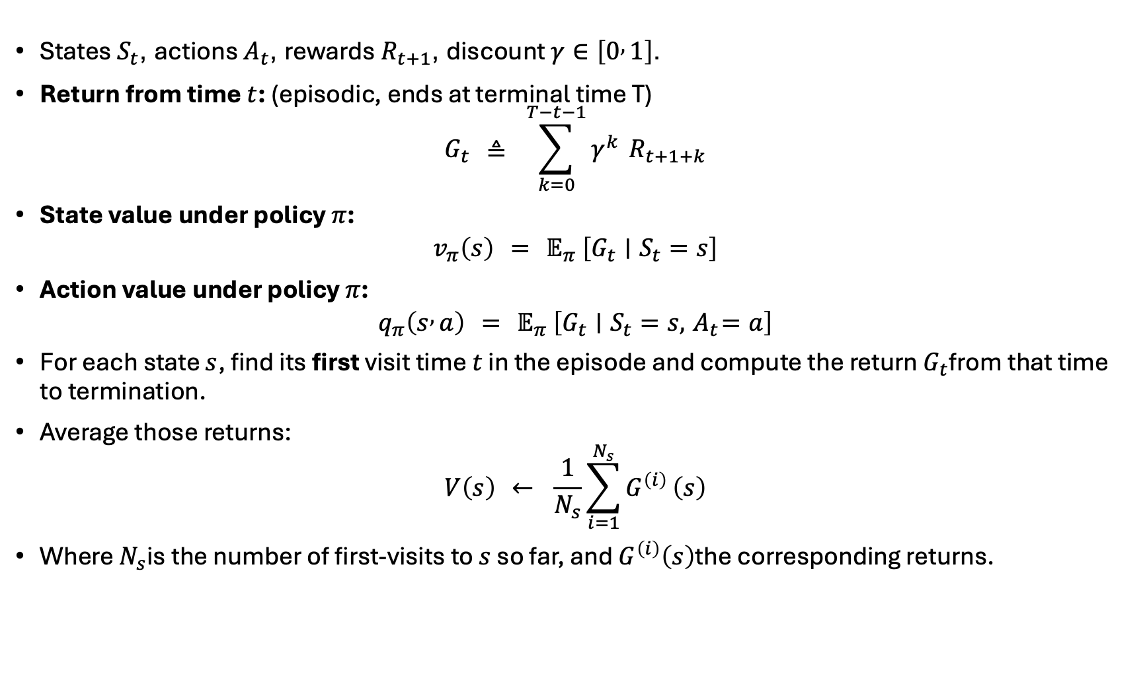
The Math
States $S_{t}$, actions $A_{t}$, rewards $R_{t+1}$, discount $γ∈\left[0 , 1\right]$.
Return from time $t$: (episodic, ends at terminal time T)
$$G_{t} ≜ \sum_{k=0}^{T−t−1}{γ^{k}} R_{t+1+k}$$
State value under policy $π$:
$$v_{π}\left(s\right) = 𝔼_{π} \left[G_{t}∣S_{t}=s\right]$$
Action value under policy $π$:
$$q_{π}\left(s , a\right) = 𝔼_{π} \left[G_{t}∣S_{t}=s,{ A}_{t}=a\right]$$
For each state $s$, find its first visit time $t$ in the episode and compute the return $G_{t}$from that time to termination.
Average those returns:
$$V\left(s\right) ← \frac{1}{N_{s}}\sum_{i=1}^{N_{s}}{G^{\left(i\right)}}\left(s\right)$$
Where $N_{s}$is the number of first-visits to $s$ so far, and $G^{\left(i\right)}\left(s\right)$the corresponding returns.
Notes:
The way that return is calculated is to calculate the return at each time multiplied by a certain ‘discount’ weight that multiplies depending on whether the reward is more recent or earlier.
The value of being in state s under policy pi is the expected (average) return given that we start in state s at time t. The average total discounted reward you can expect if you behave according to policy pi.
The value of taking action a in state s and following policy p afterwards. The long-run return in taking action a in state s and following pi afterwards.
Capital V is the estimate of lowercase v taken by averaging the returns.

Slide 10
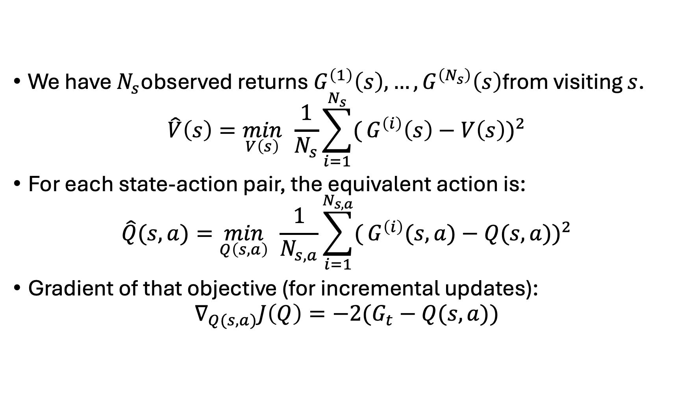
The Math
We have $N_{s}$observed returns $G^{\left(1\right)}\left(s\right),…,G^{\left(N_{s}\right)}\left(s\right)$from visiting $s$.
$$\hat{V}\left(s\right)=\min_{V\left(s\right)} \frac{1}{N_{s}}\sum_{i=1}^{N_{s}}{(}G^{\left(i\right)}\left(s\right)−V\left(s\right))^{2}$$
For each state-action pair, the equivalent action is:
$$\hat{Q}(s, a)=\min_{Q\left(s, a\right)} \frac{1}{N_{s,a}}\sum_{i=1}^{N_{s,a}}{(}G^{\left(i\right)}(s, a)−Q(s, a))^{2}$$
Gradient of that objective (for incremental updates):
$$∇_{Q(s, a)}J\left(Q\right)=−2(G_{t}−Q(s, a))$$

Slide 11

Monte Carlo Qualities and Use Cases
Monte Carlo uses model-free learning, with emphasis on stochastic outcomes and unbiased estimates.
It is easily parallelizable with simulations running on multiple machines at the same time.
It is also very useful for high-dimensional problems.
However, it also requires complete episodes and is not very efficient.
Returns can vary widely between episodes with slow convergence.
It is also not very suitable for online, continual environments that change in real-time.

Slide 12
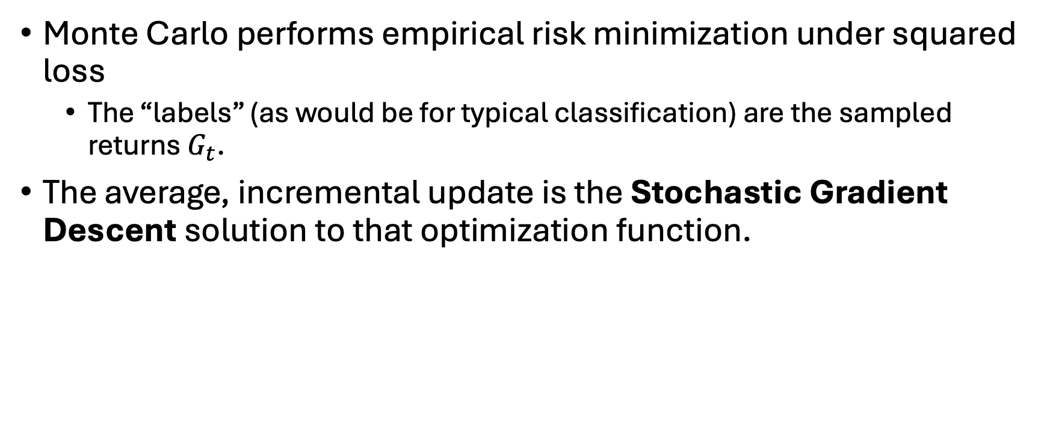
In Application
Monte Carlo performs empirical risk minimization under squared loss
The “labels” (as would be for typical classification) are the sampled returns $G_{t}$.
The average, incremental update is the Stochastic Gradient Descent solution to that optimization function.

Slide 13
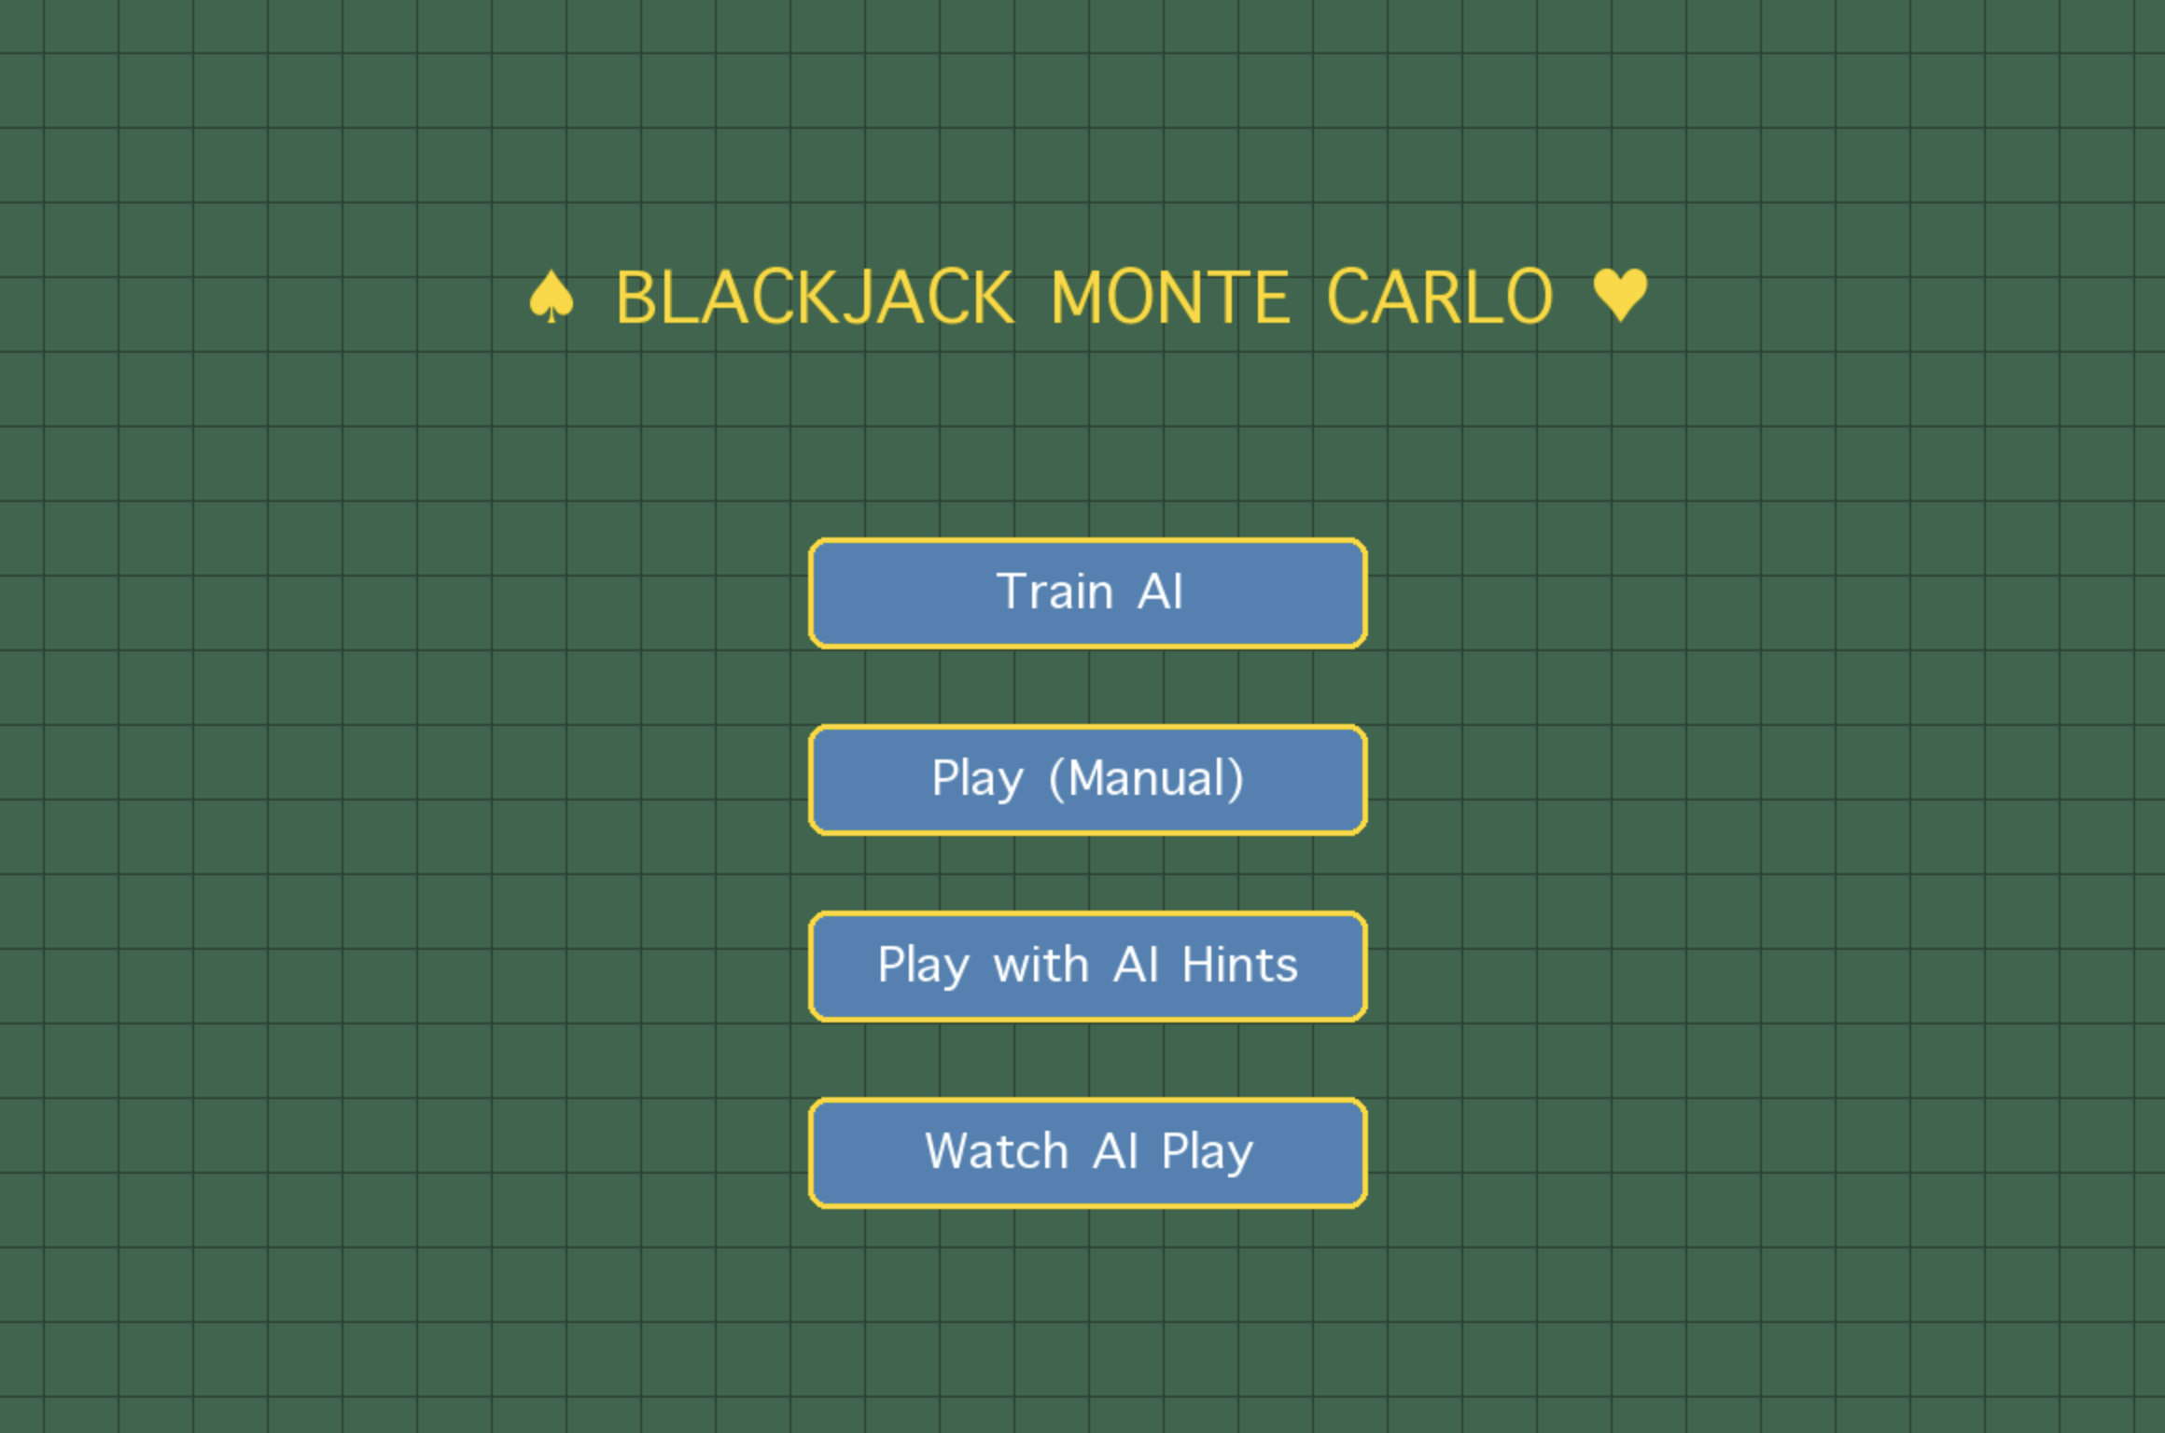
Demonstration - Blackjack

Slide 14
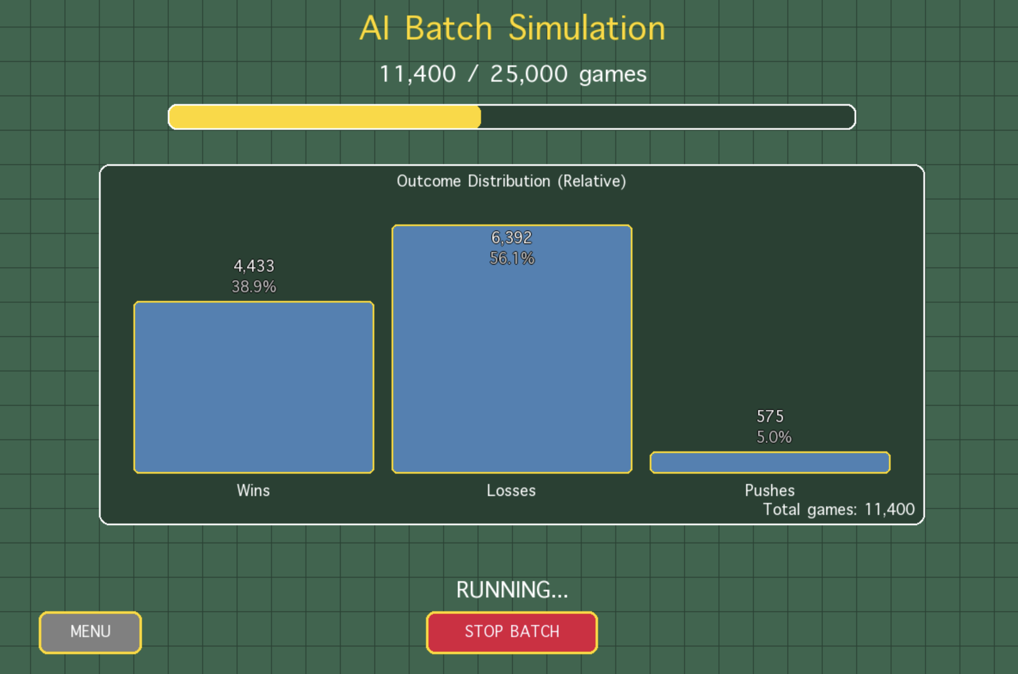
Demonstration - Blackjack

Slide 15
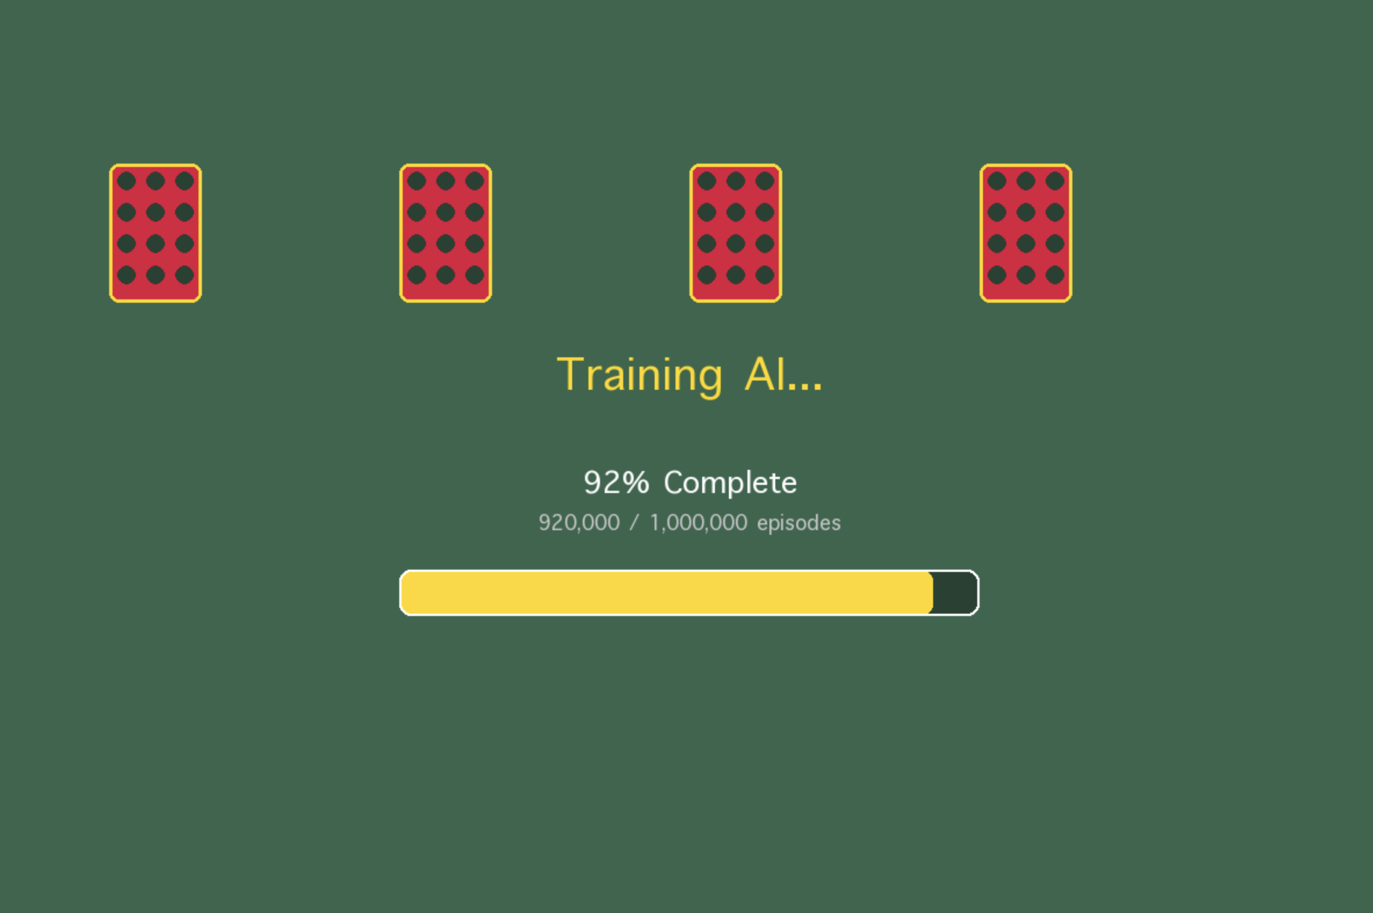
Demonstration - Blackjack

Slide 16
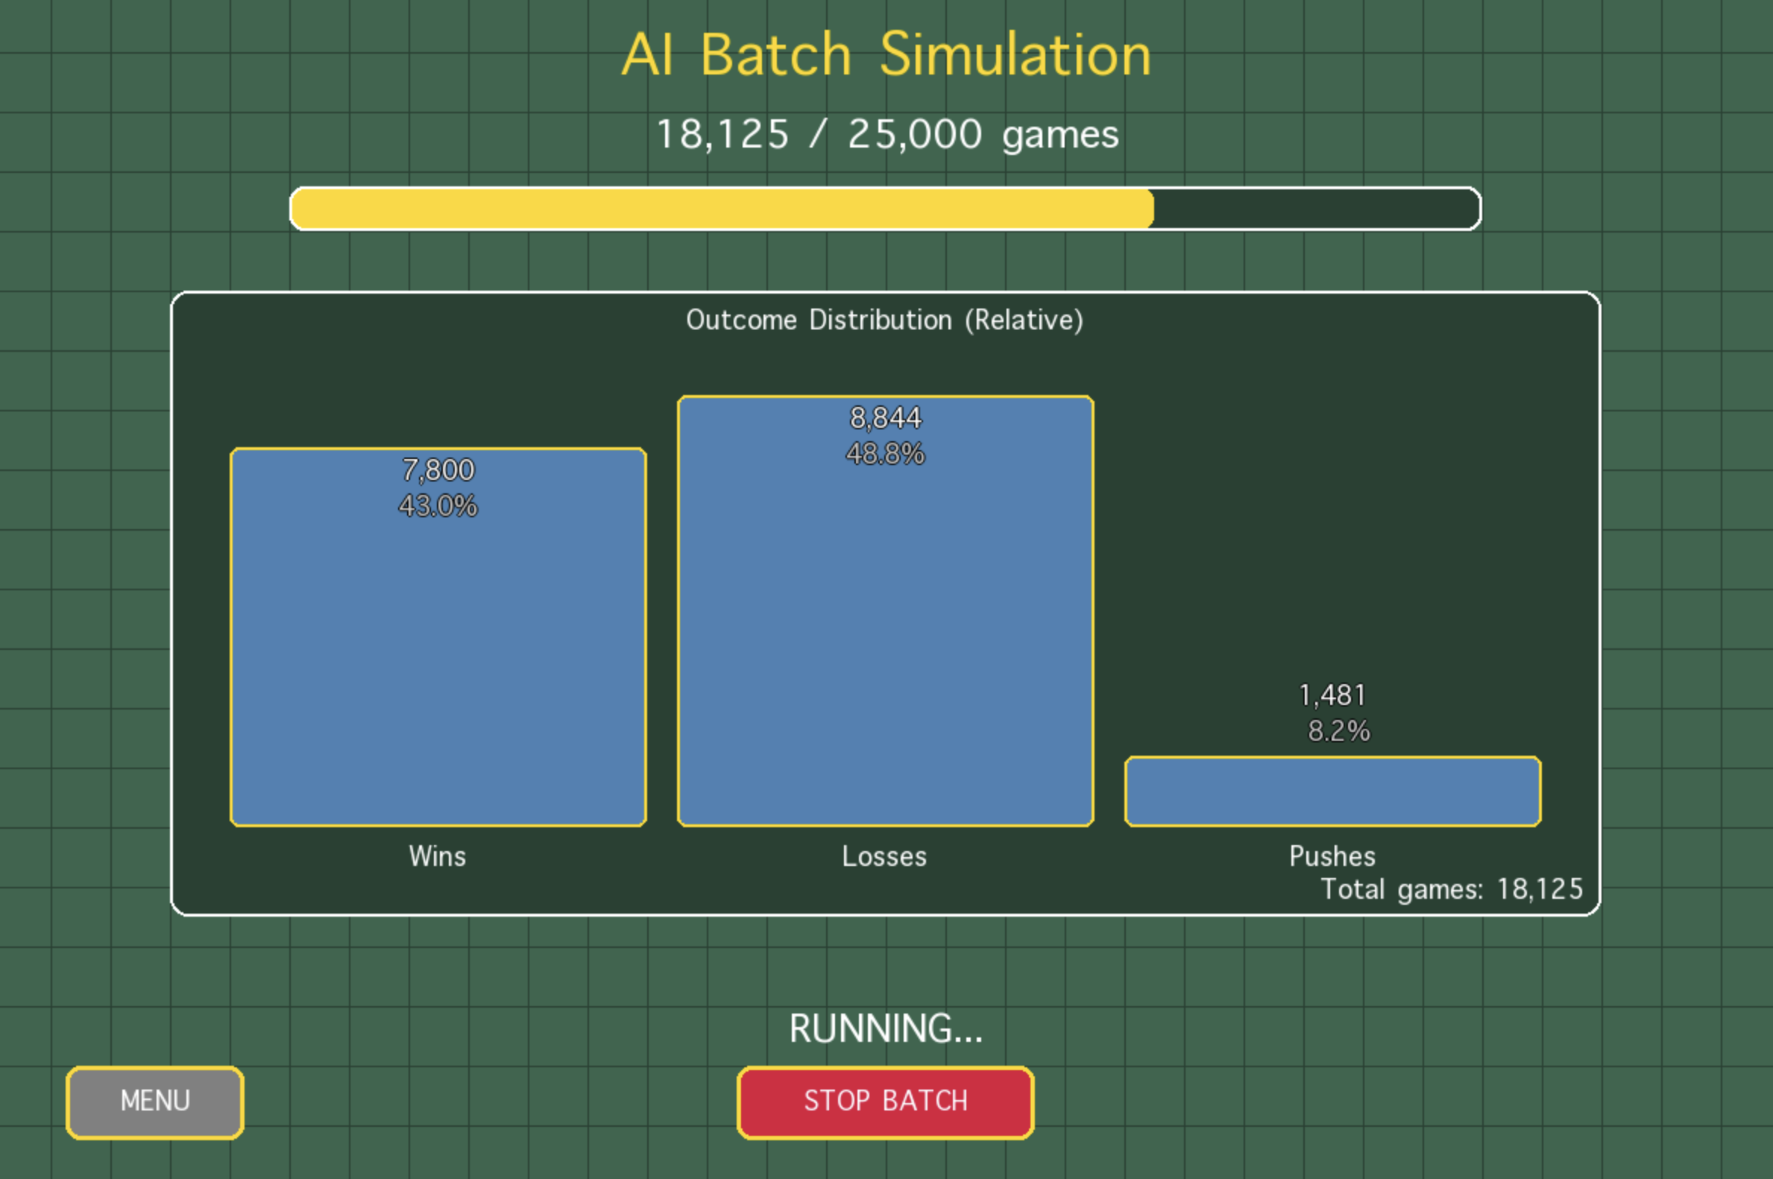
Demonstration - Blackjack

Slide 17
Demonstration - Blackjack
Before Training
The agent begins with no strategy (random play).
Decision-making is effectively coin-flip based:
Hits and stands are chosen without evaluating expected outcomes.
Expected performance is close to break-even in theory, but typically trends worse due to house edge and random mistakes.
Win/Loss/Push rates often approximate:
~35–40% Wins
~55–60% Losses
~5–8% Push
Outcome resembles an inexperienced human player with poor decision consistency.

Slide 18
Demonstration - Blackjack
After Training on 1,000,000 Episodes
Agent learns an optimal policy through Monte-Carlo Control and value estimation of game states.
The policy converges to decisions that maximize expected long-term reward (not just short-term survival).
Marked improvements in outcome distribution:
Wins rise, Losses fall, Pushes remain stable.
Typical trained performance approaches:
~42–45% Wins
~47–50% Losses
~7–8% Push
Results now resemble a player following a Basic Strategy-level policy, reducing the casino’s edge.

Slide 19
Demonstration - Blackjack
Key Observations
Training shifts the agent from reactive guessing to statistical decision-making.
Loss rate decreases significantly due to:
Avoiding unnecessary hits that cause busts.
Recognizing profitable stand situations.
Improved handling of usable aces and dealer up-card modeling.
Performance can be further improved by:
Reducing epsilon (exploration) after training
Increasing training beyond 1M episodes
Adding card-counting or Q(λ) enhancements

Slide 20

Conclusion
Monte Carlo simulations are a valuable RL technique that emphasize the law of large numbers to approximate distributions.
Though they have their drawbacks, they remain incredibly useful in mimicking stochastic problem spaces and providing agents with certainty in uncertain environments.

Slide 21

Conclusion
The House Always Wins

